Slide 1
Salary calculation by Python
Name: Tim Chen
Date: 5/11/2019

Slide 2


Palate-cleansers

Slide 3
Agenda
Progress
Original Data
Challenges and Solutions
Libraries
Demo Time
Q&A

Slide 4
Progress
1. If the employees are on time?
2. If there’s daily sales bonus?
3. Join Everything
4. Export to Excel

Slide 5
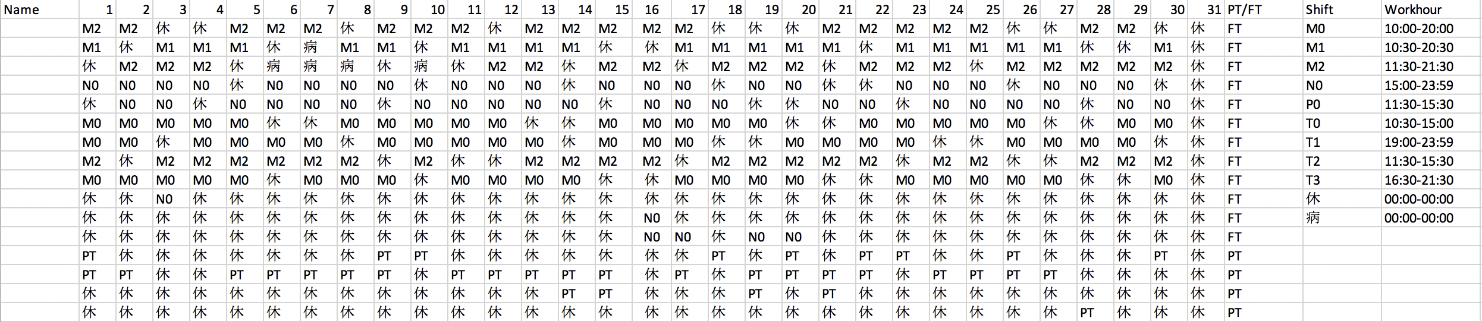
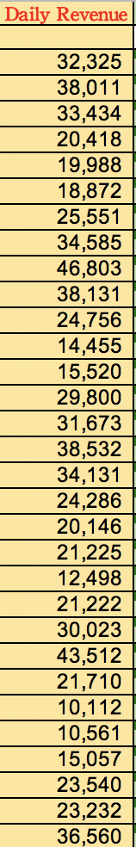
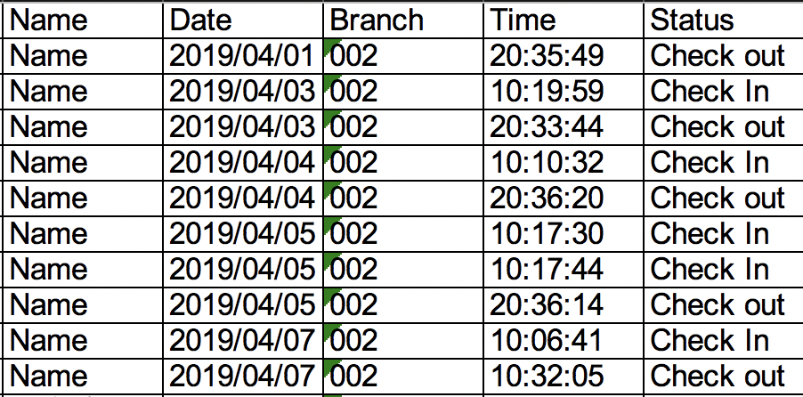
Original Data

Slide 6
Challenge & Solution 1 – countlate.py
1. pandas.drop_duplicates(subset= column name],keep='first')

Slide 7
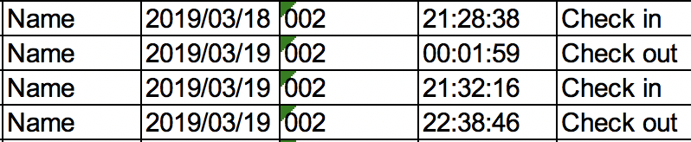
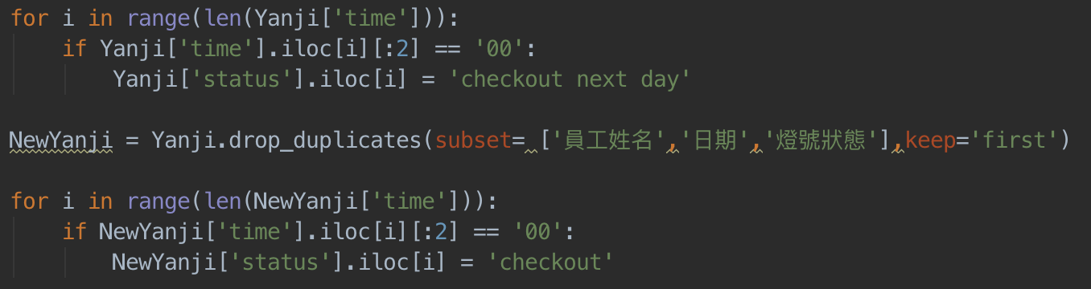
Challenge & Solution 1 – countlate.py

Slide 8
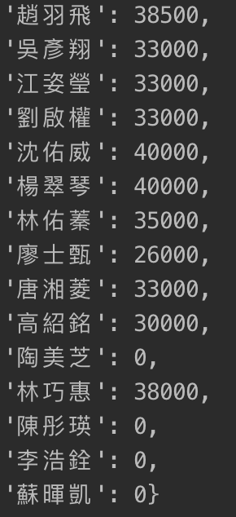
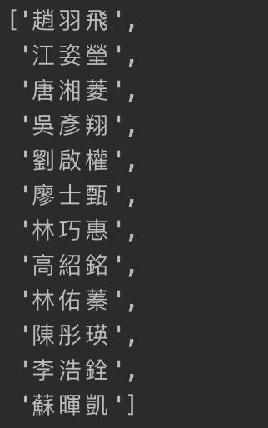
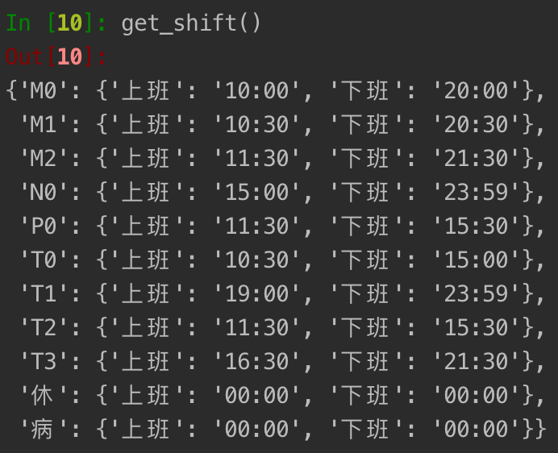
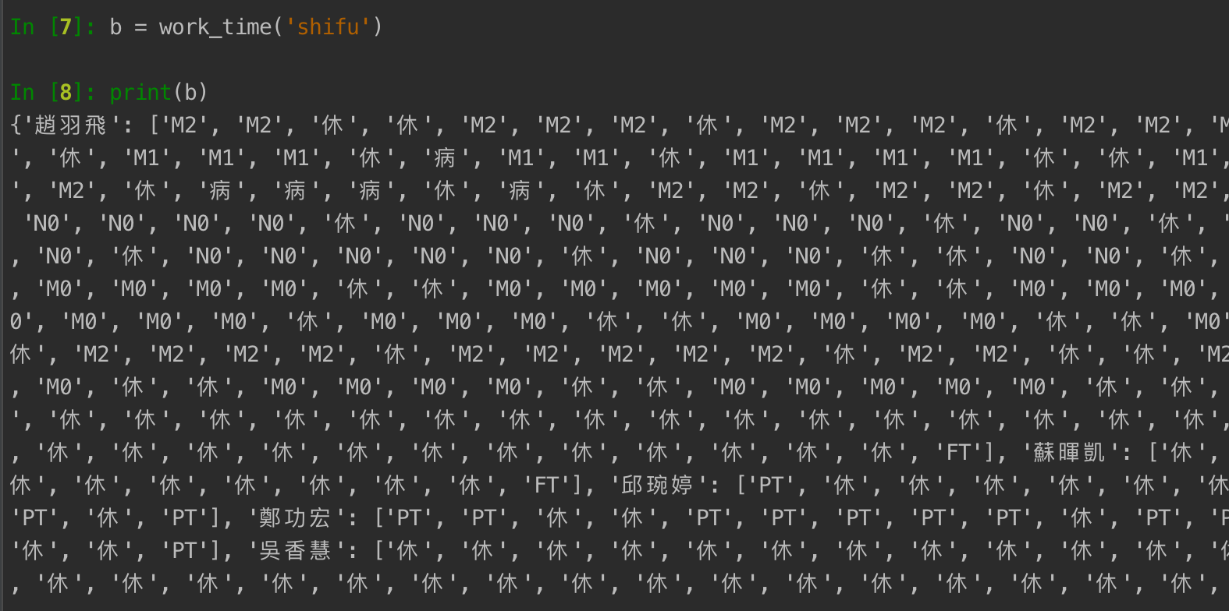
Challenge 2

Slide 9
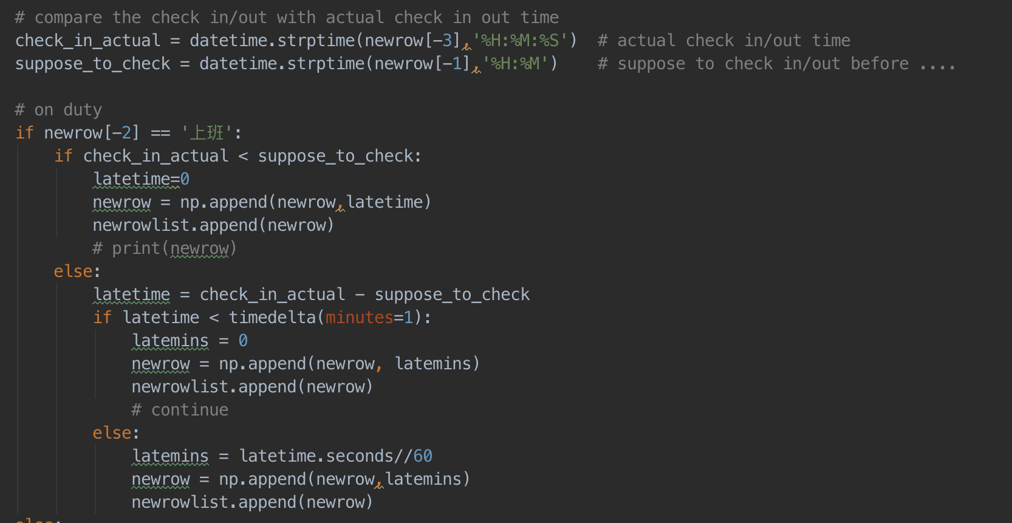
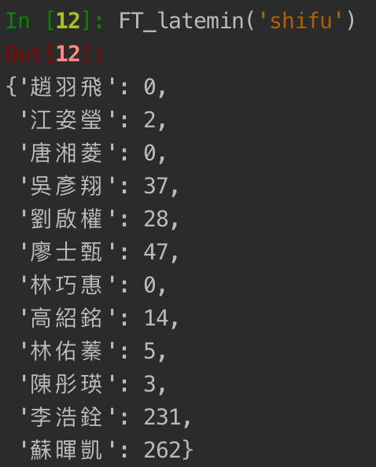
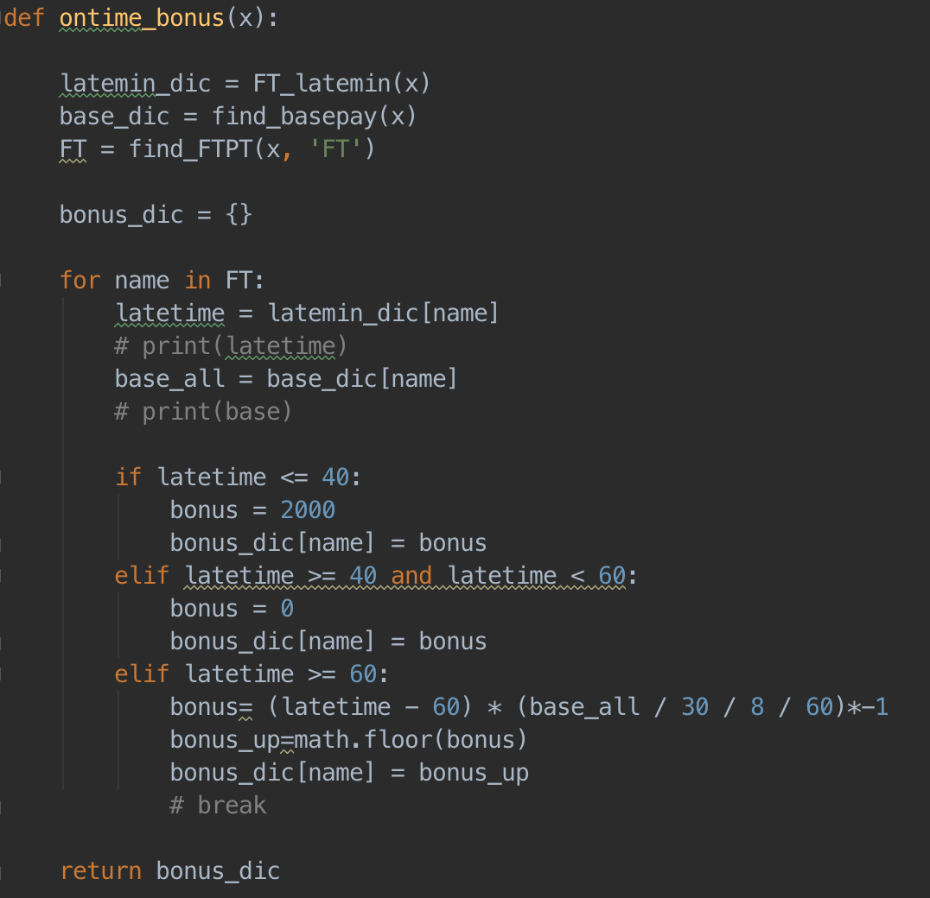
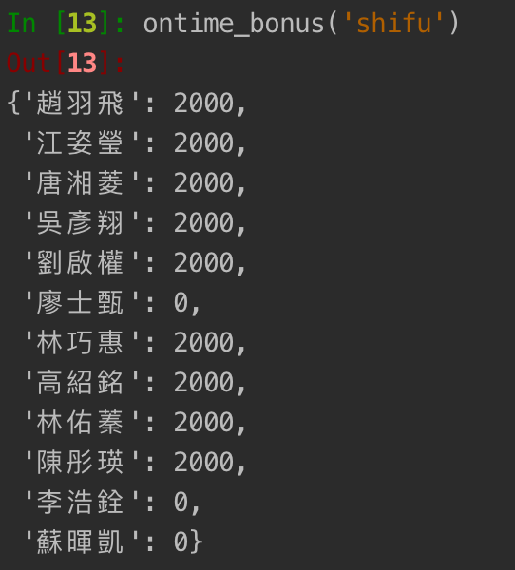
Solution 2

Slide 10
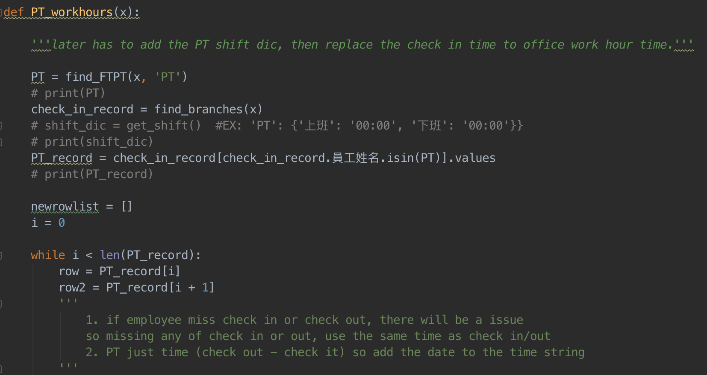
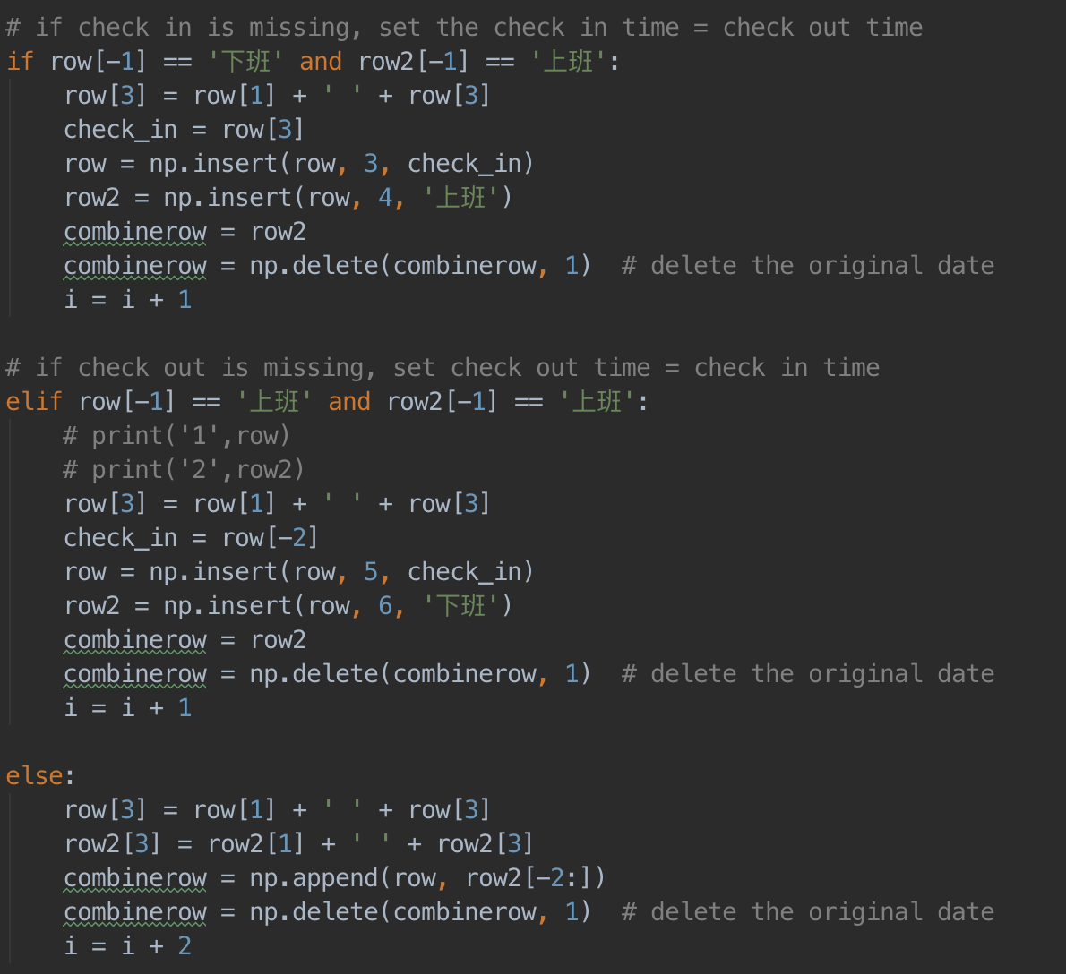
Challenge & Solution 3 – PT_workhour()
PT = find_FTPT(x, 'PT') check_in_record = find_branches(x)
PT_record = check_in_record [check_in_record.EmployeeName .isin(PT)].values

Slide 11
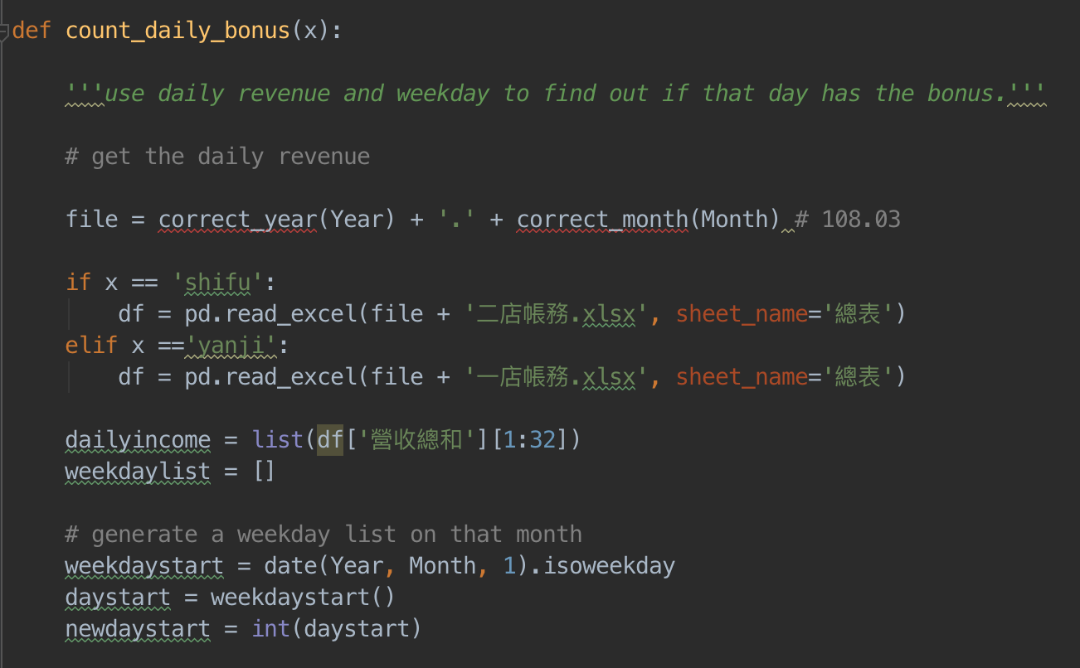
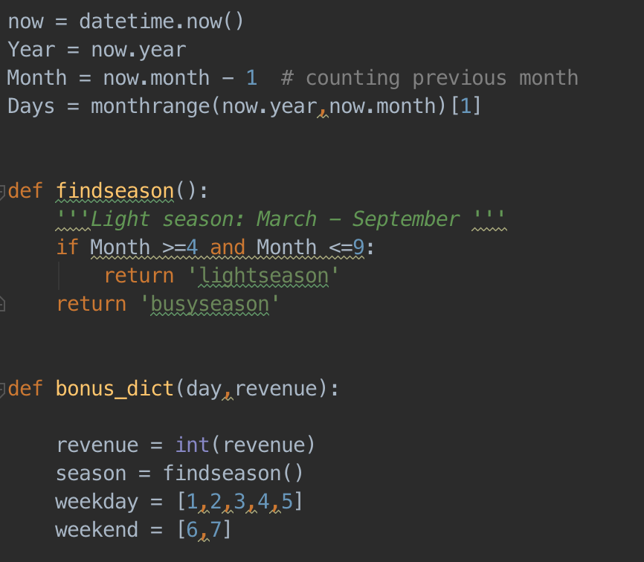
Challenge & Solution 4 –
count_daily_bonus()
weekdaystart = date(Year, Month, 1).isoweekday
4/11 – Thursday
5/11 - Saturday

Slide 12
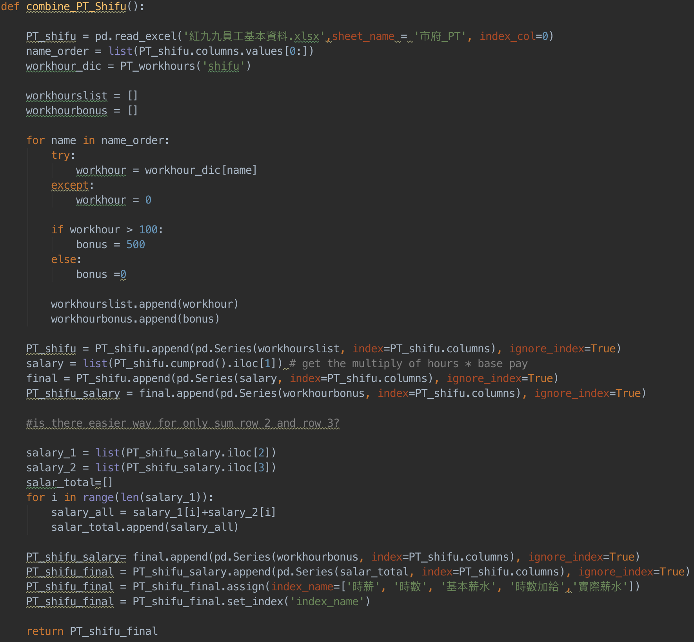
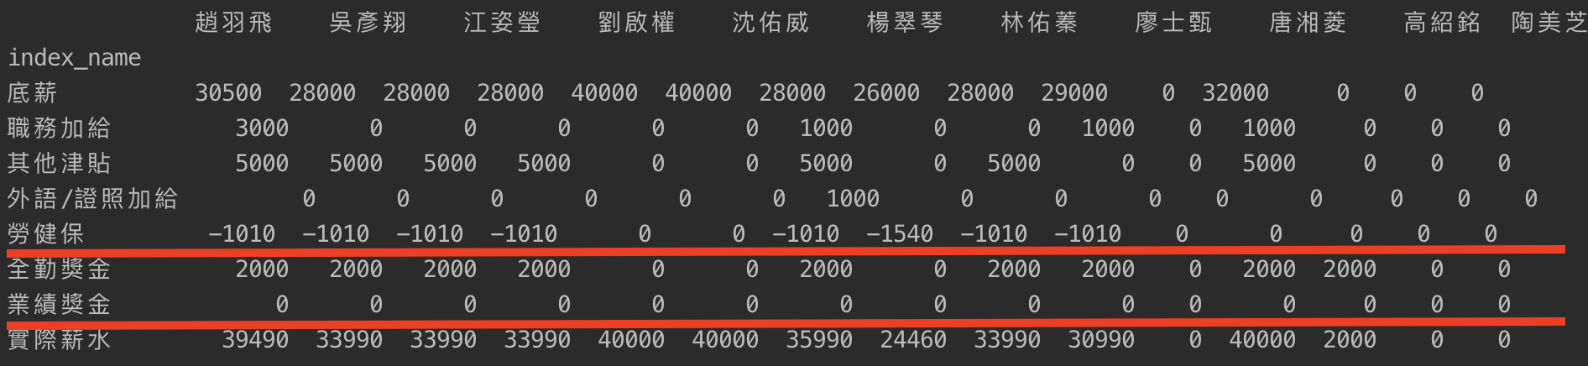
Final Challenges – Join Everything for FT

Slide 13
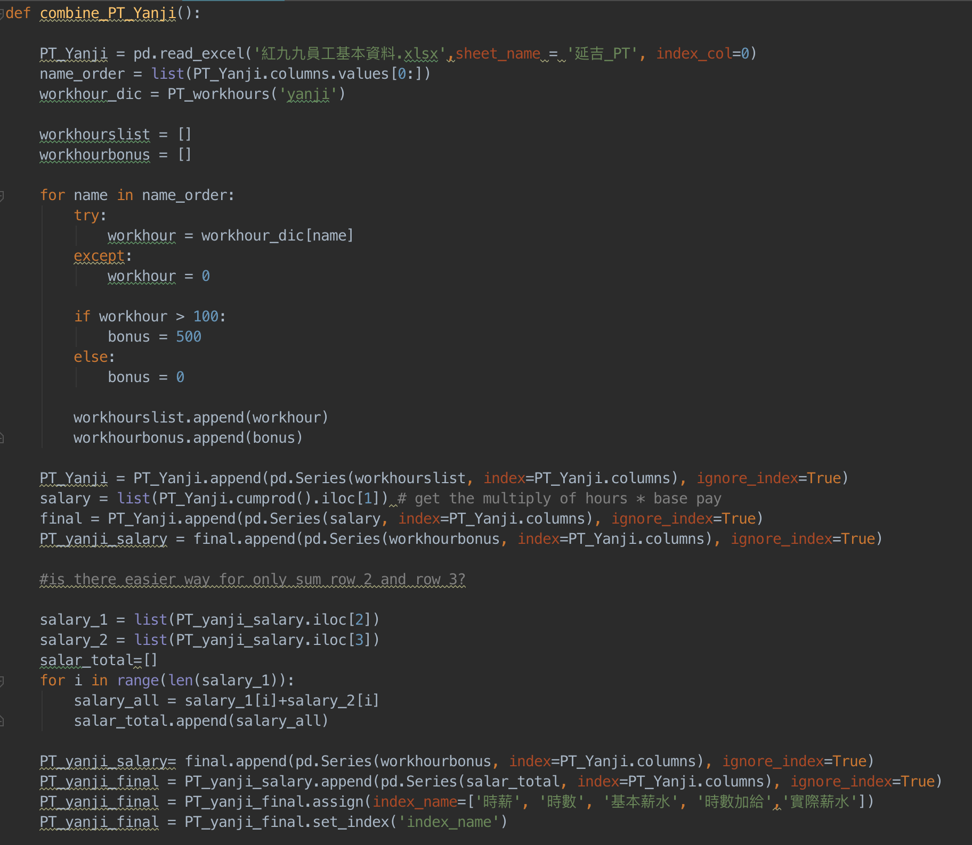
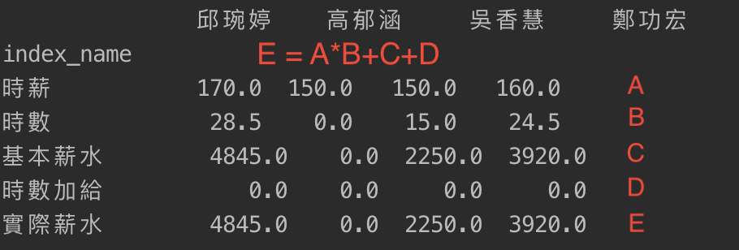
Final Challenges – Join Everything for PT

Slide 14
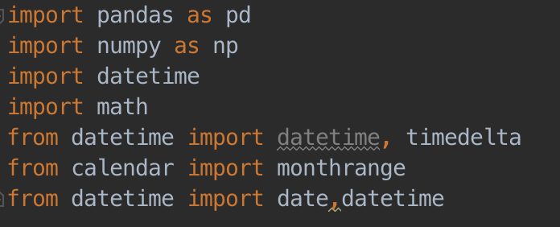
Libraries

Slide 15
What’s next……
Employee Sick Leaves and Leaves……

Slide 16
Q&A
Thank you

